Slide 1


Slide 2


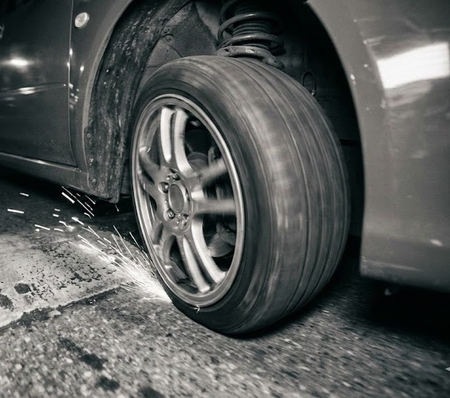

The
Problem
400+ accident deaths across Romania in 2023
Emergency vehicles lose critical seconds slowing down.
Traditional bumps damage suspensions.

Slide 3

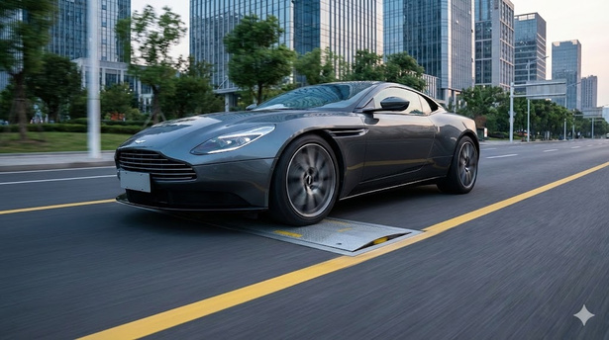
The
Solution
Adaptive Response
Legal speeds results in a perfectly flat road.
Instant Reaction
AI surveillance camera detects speed
Traffic lights
In case of high speeds the traffic lights go red

Slide 4
Servo motors designed for high torque with worm gear
Key
Heavy Load Capacity to support trucks and buses.
Features
IP68 Weather Sealed mechanism for water protection
It reacts to the road conditions

Slide 5
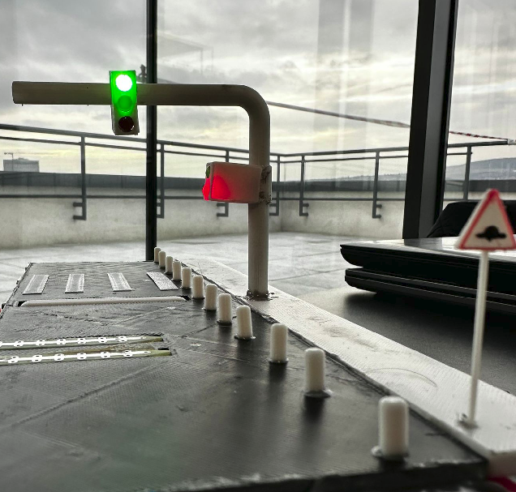
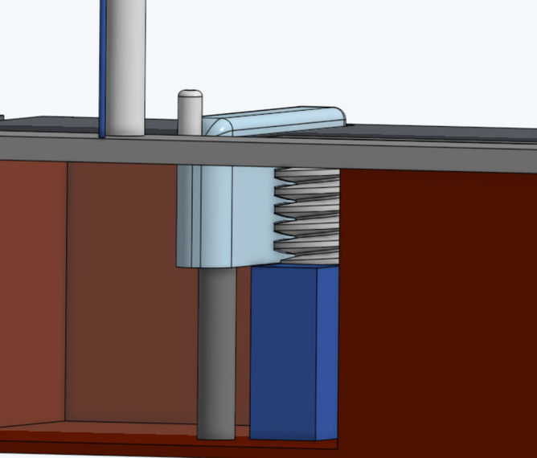
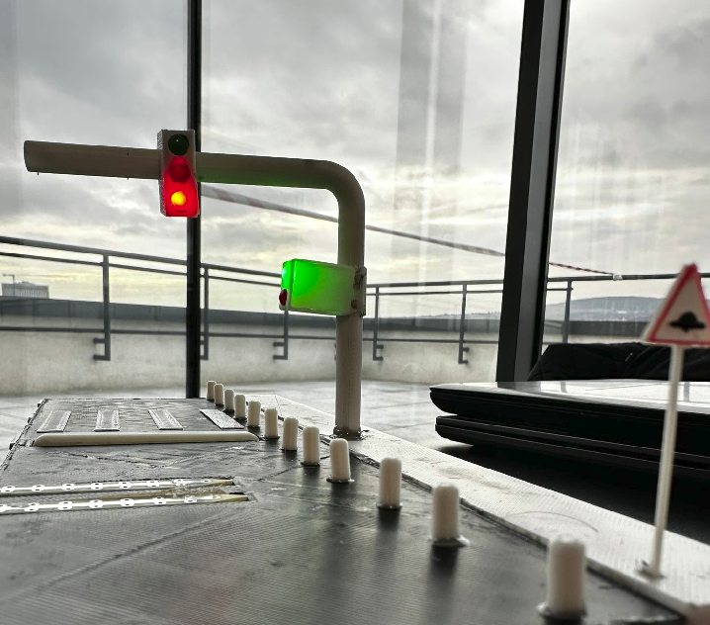

Slide 6


COMPETITION
Integrates Intelligent Transport Systems and detection but lacks enforcement
Proven and efficient physcal product, but expensive and rudimentar

Slide 7
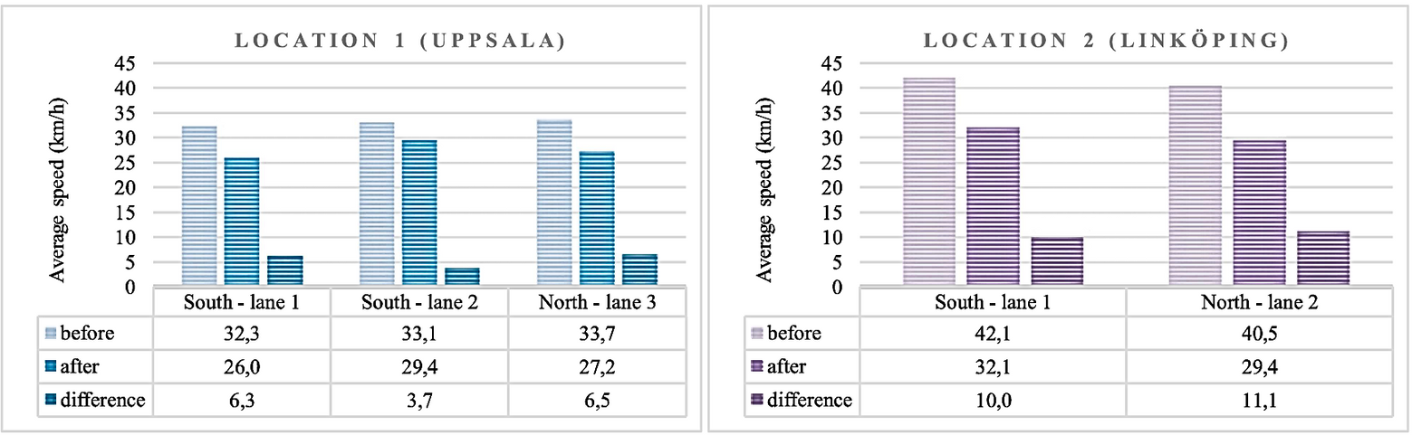
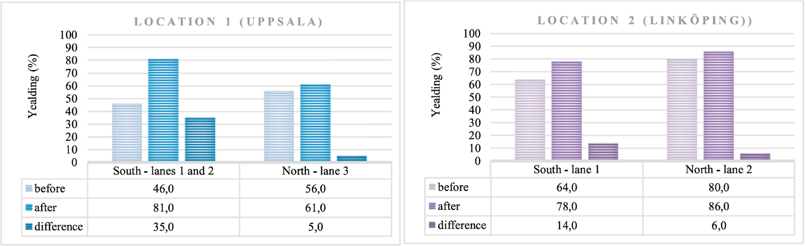

Slide 8
Why
Choose Us?
Emergency Access
Zero delay for emergencies
Neighbourhood-Friendly
Kids, pets, and pedestrians are safe
Smart Investment
Integrates with future autonomous
vehicle networks.

Slide 9
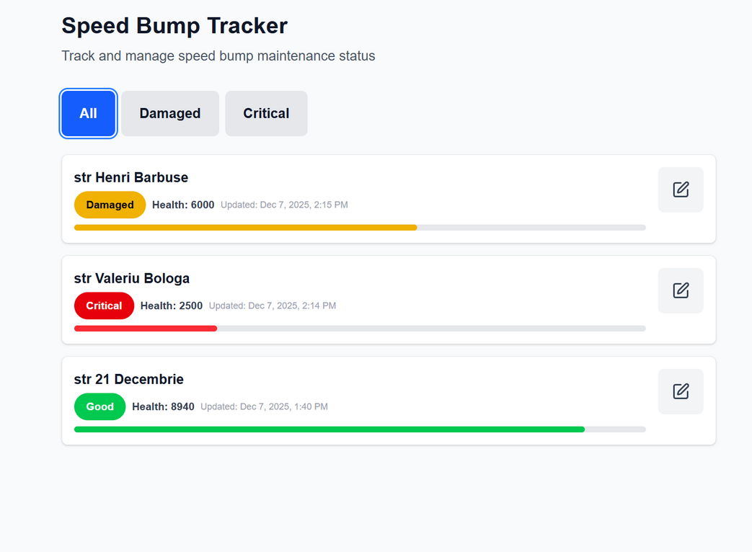
Connected
Tech
Real-Time Data
The bump acts as a traffic counter, sending stats to the dashboard.
Predictive Maintenance
The system monitors motor loads and temperature, alerting maintenance teams before a breakdown occurs.

Slide 10






MARKET EXPANSION

Slide 11

Meet
The Team
Pohl Adam
Lusca Vlad
Ghimpu Stefan
Salajan David
Rusu Mihnea

Slide 12
Let's Build Safer, Smarter Roads.
"Technology that clears the way for safety."
www.reallygreatsite.com

